Slide 1
Human Resources Dataset Analysis

Slide 2

Introduction
The Dataset contains detailed information about employees of a company, covering a wide range of personal, professional, and organizational aspects. The data is generally designed to provide a comprehensive overview of the workforce, enabling analysis of performance, career planning, human resource management, or studying factors affecting employee retention (e.g., turnover or retention).

Slide 3
01
Plan
Exploring and cleaning data
Question Analysis
Data Visualization

Slide 4
01
Data Overview
The data contains sensitive information (e.g., names and salaries), requiring careful handling in compliance with data protection laws.
The dates indicate that the data spans a long period (from 2012 to 2022), allowing for long-term trend analysis.
Columns like "Years Since Last Promotion" and "Years With Curr Manager" suggest the company’s focus on tracking career progression and management relationships.

Slide 5
Potential Business Questions
02
1 . Attrition Analysis:
What factors are correlated with employee attrition?
Is low salary or frequent travel linked to resignations?
Are there specific departments or roles with higher attrition?
Is overtime work linked to resignations?
Does the number of years at the company or time since the last promotion affect likelihood of leaving?

Slide 6
2. Salary Analysis:
Are there salary differences between departments?
Are there gender or ethnicity pay gaps?
3. Performance & Retention:
What factors affect long-term employee retention?
Is there a relationship between education field and job role?
Does getting promoted influence?

Slide 7
03
HR Results and data Visualization

Slide 8
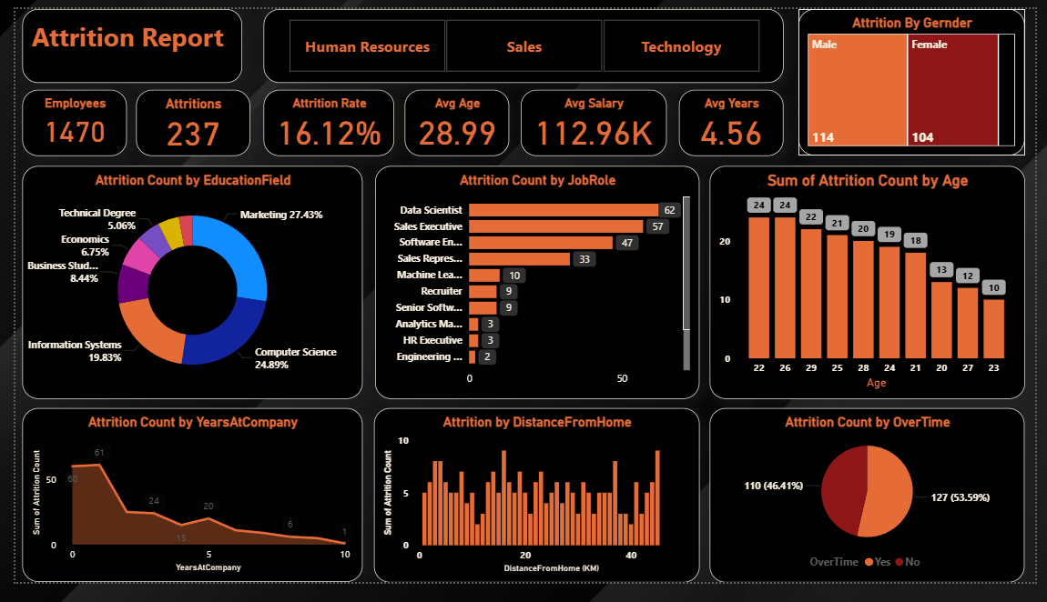
Dashboard

Slide 9

What we got from this insights?
General Statistics : There are 1,470 employees, with 237 having left, meaning an attrition rate of 16.12%. The average age is 28.99 years, the average salary is 112.96K, and the average years of service is 4.56 years.
Attrition by Gender : Men (114) have a slightly higher attrition rate than women (104), but the gap isn’t significant.
Attrition by Education Field: Computer Science (24.89%) and Information Systems (19.83%) have the highest attrition rates, while Economics (6.75%) has the lowest.
Attrition by Age : Most attrition occurs in the 20-24 age group, decreasing as age increases.
Years at Company: The highest attrition is in the first year (61), dropping significantly with more years of service.
Overtime: 46.41% of those who left worked overtime, suggesting that work pressure might be a factor.

Slide 10
Overall Conclusion
The company faces high attrition among new employees (first year) and in technical fields like Computer Science.
Overtime and proximity to home may contribute to attrition.
The company needs to improve the work environment for new hires, reduce overtime, and offer incentives for technical roles to lower attrition.

Slide 11
Thank you!
Do you have any questions?

